Slide 1
Retail Website
Presented By:
P. Rahul
N. Hariteja
K. ManiSowmya
D. Sreedhar Reddy
S. Sai Kaushik
S. Venkatesh
V.S. Soundarya

Slide 2

MODULES:
Customer
Login/Signup
Admin - admin, admin@123
My account, My Orders
Information, Service
Home page
Navigation bar
Shop
Admin
Dashboard
Catalog
Sales
Customer
marketing
Report

Slide 3
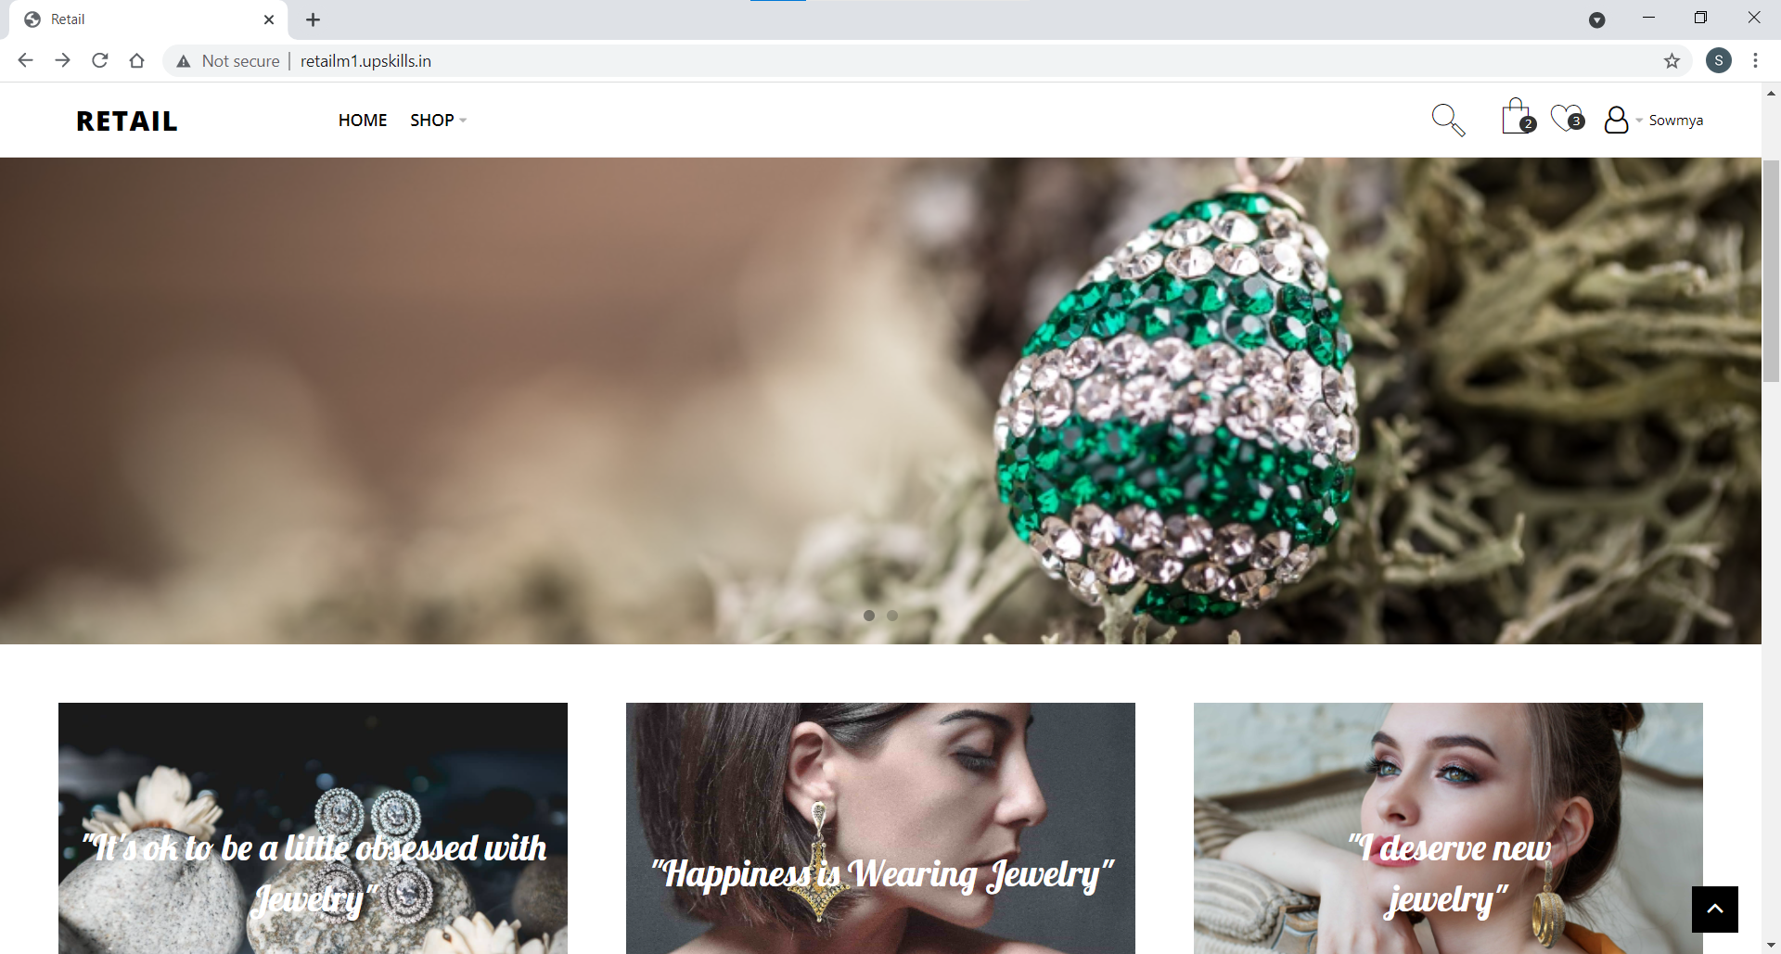
HOMEPAGE
Features:
Home Button
Shop Button
Cart Button
Wish-list Button
User Icon
Images

Slide 4
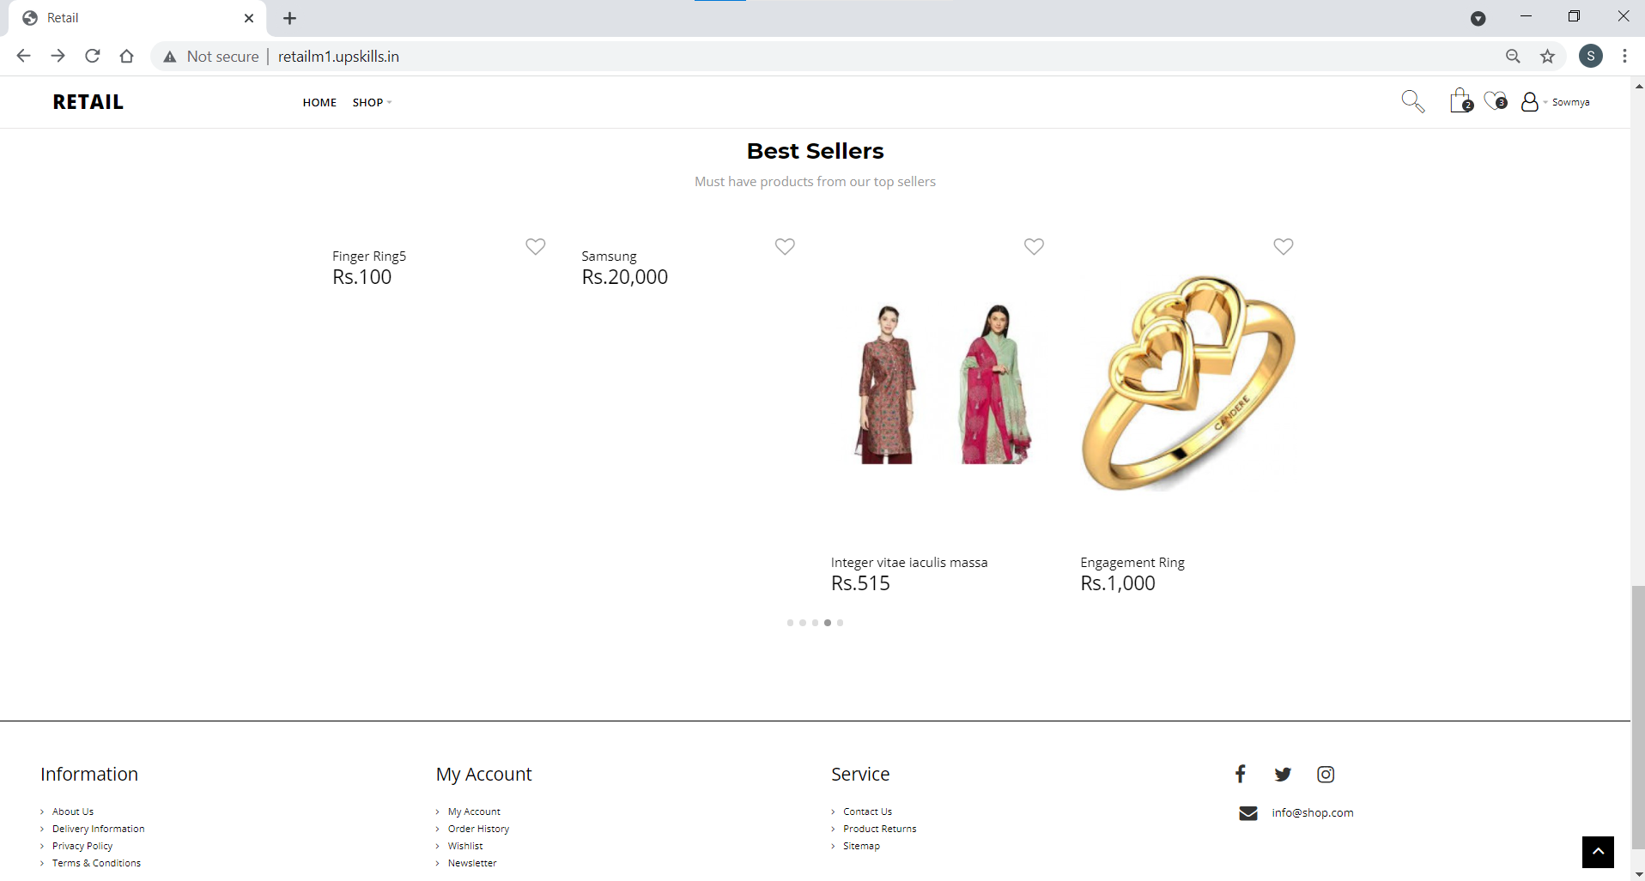
Features:
My Account
Information
Service
Social Network Icons

Slide 5
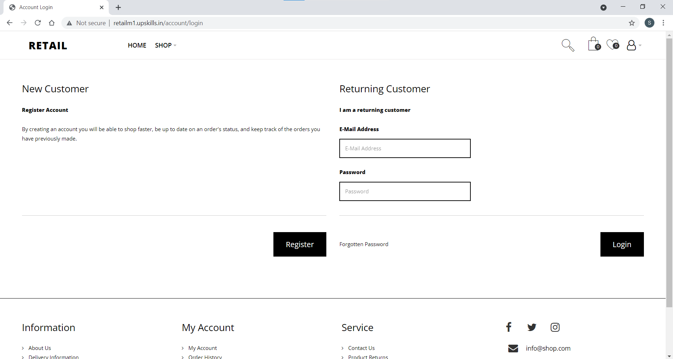
LOGIN:
Features:
Returning Customer
E-Mail Address
Password
Forgotten Password Button
Login Button

Slide 6
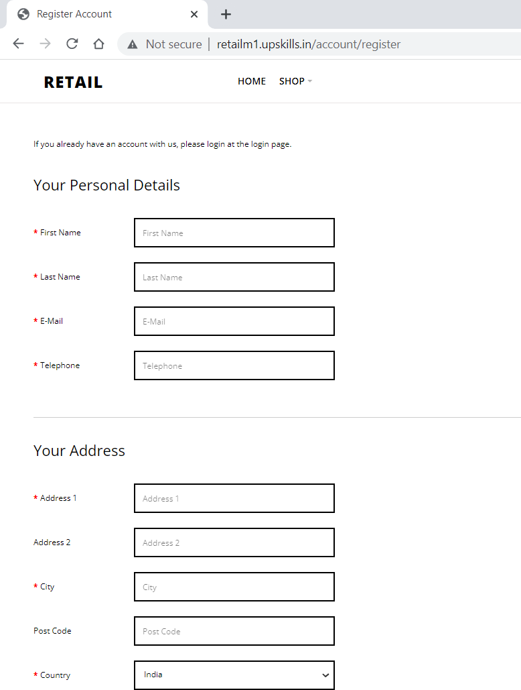
REGISTER:
Features:
First Name
Last Name
E-Mail
Telephone
Address 1
Address 2
City
Post Code
Country

Slide 7
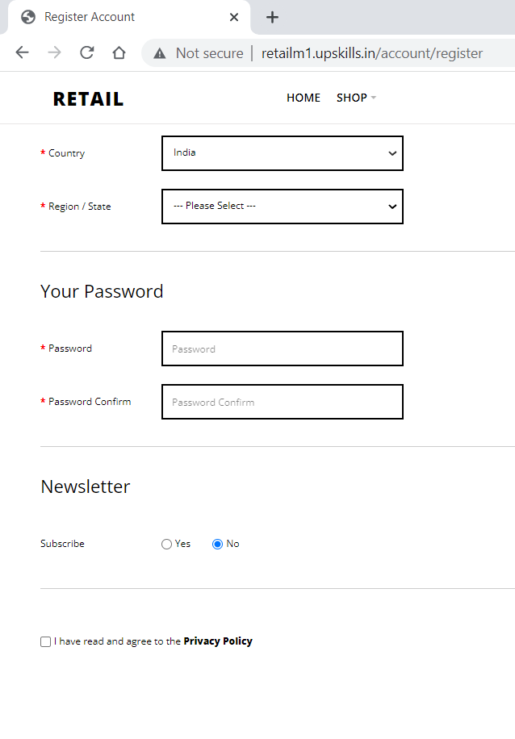
Features:
Region / State
Password
Password Confirm
Subscribing Newsletter

Slide 8
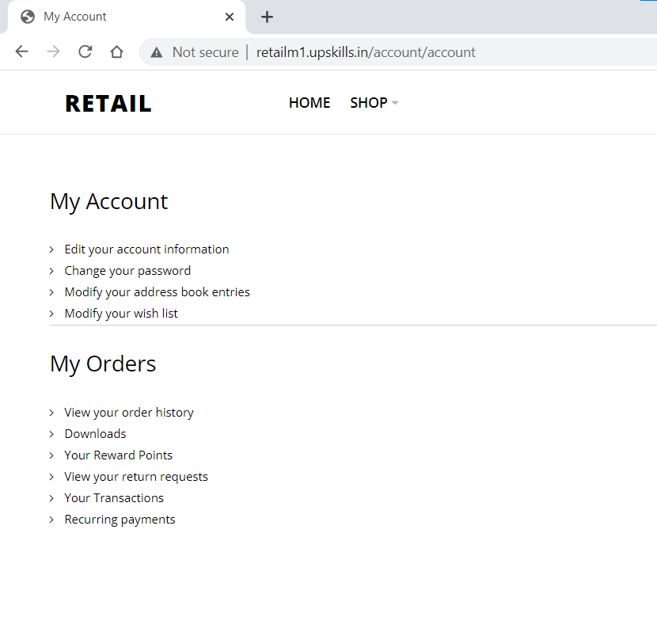
Features:
My Account
My Orders

Slide 9
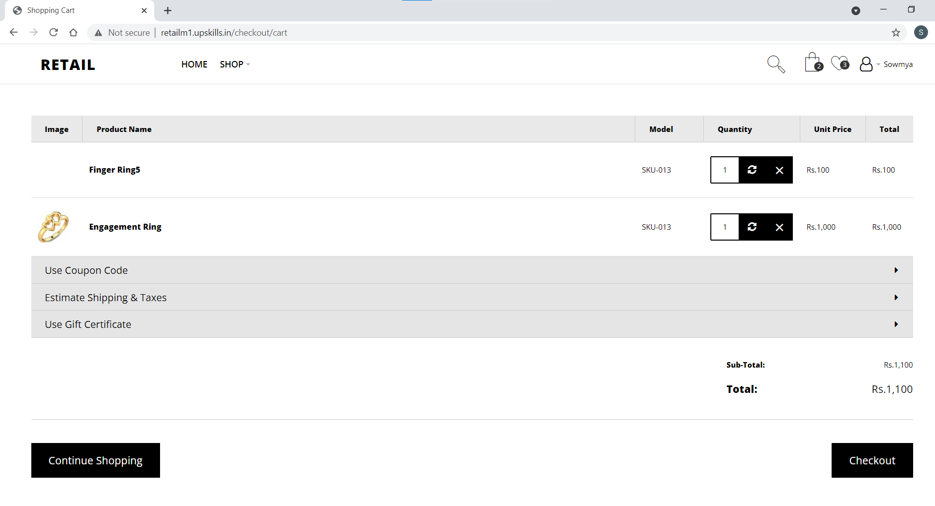
CART
Features:
Change the quantity
Remove product
Using Coupon Code
Select Shipping type
Using Gift Code
Continue Shopping Button
Checkout Button

Slide 10
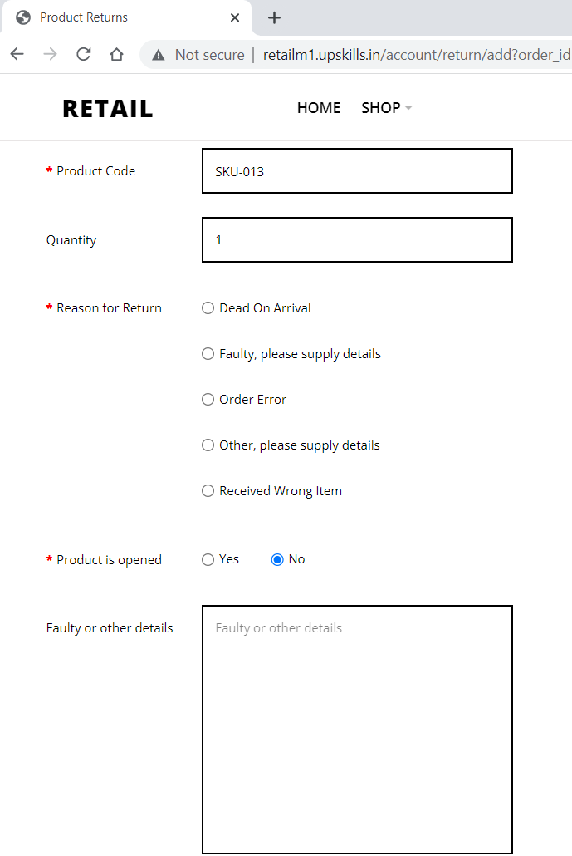
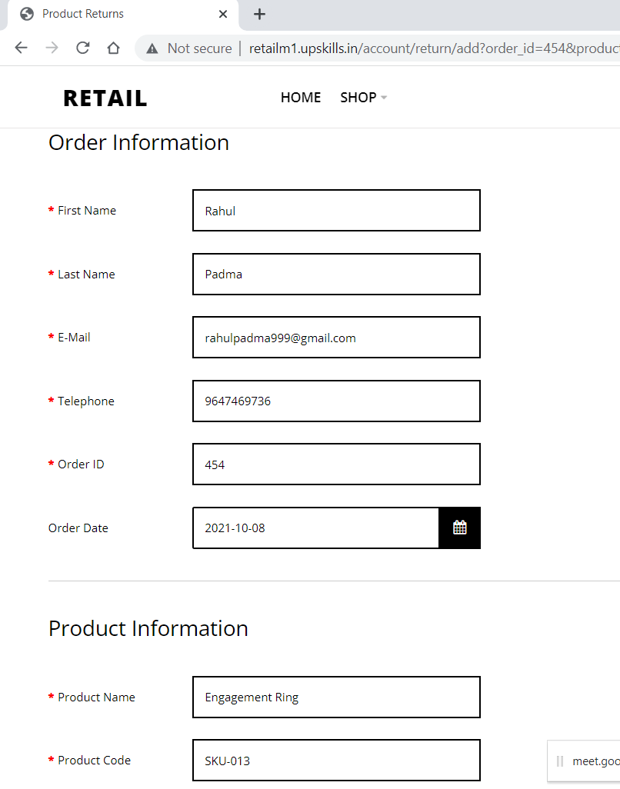
Product Return Page

Slide 11
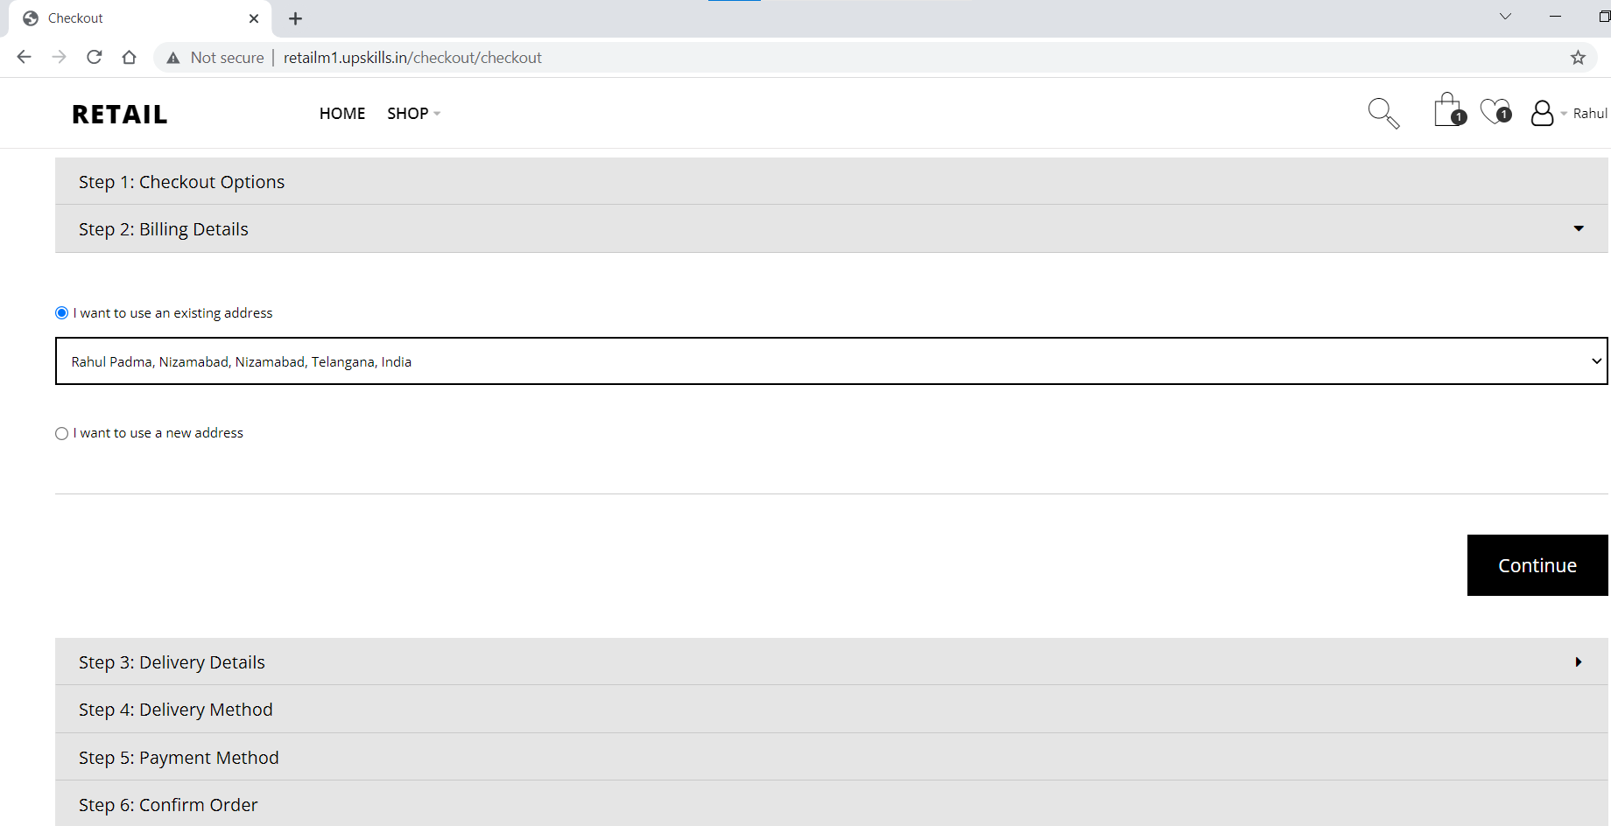
Checkout
Checkout Options
Billing Details
Delivery Details
Delivery Methods
Payment Method
Confirm Order

Slide 12
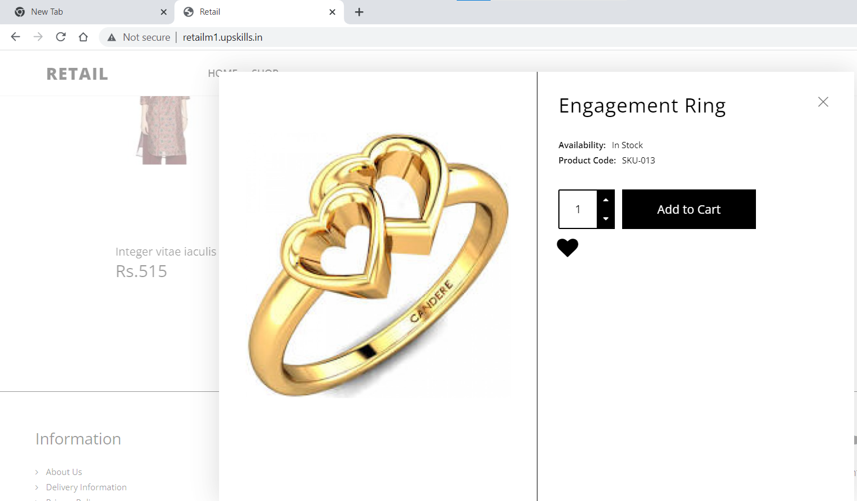
Quick View Page
Product Image
Product Name
Quantity
Add to Cart Button
Wish-List Icon

Slide 13
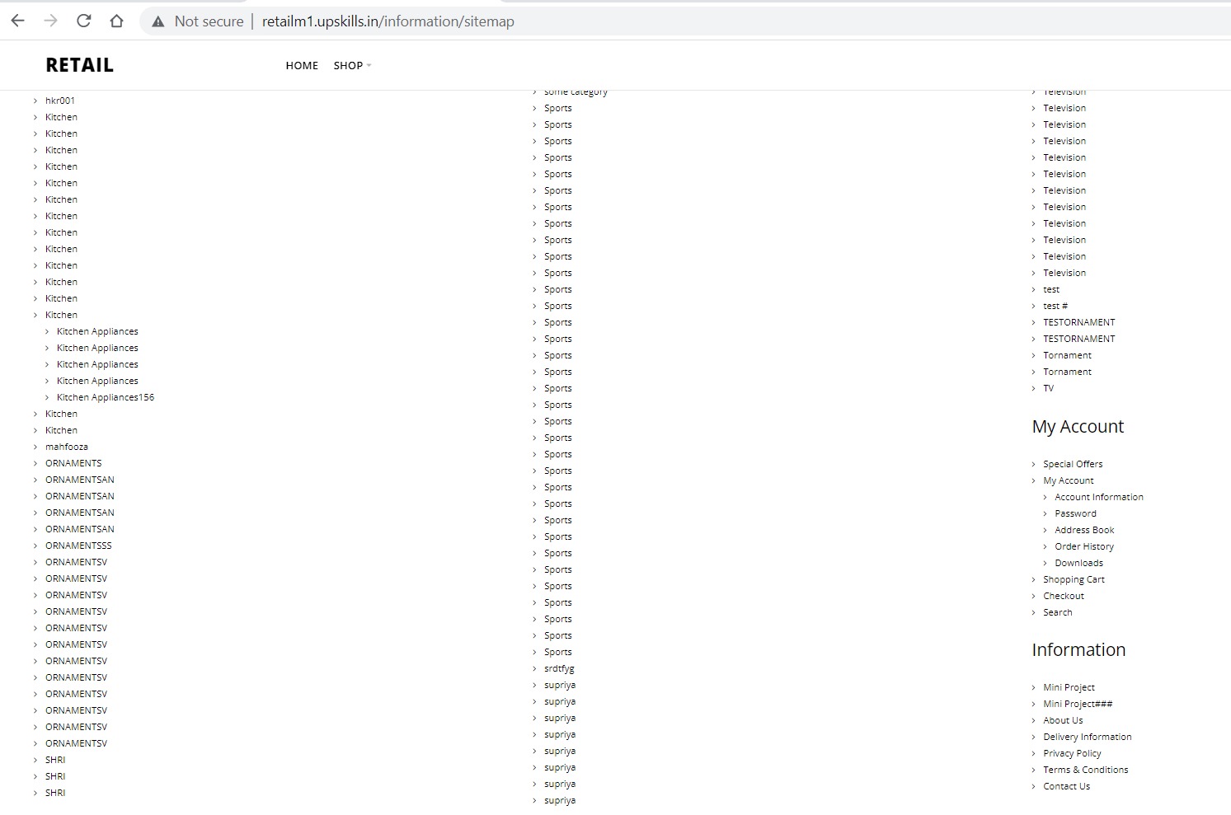
Site Map Page
Electronic Button
Television Button
My Account
Information

Slide 14
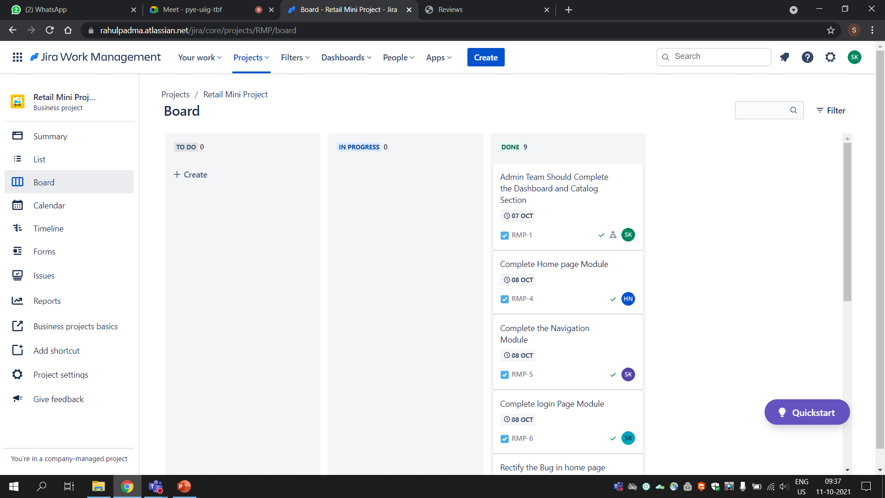
Jira:
Jira is a proprietary issue tracking product developed by Atlassian that allows bug tracking and agile project management
We used Jira to track and update our progress
Using Jira helped us in organising our work

Slide 15
Admin Webpage:
Admin webpage is the brain of any webpage
Since, we can access the customer website and make any changes there
And security for admin webpage is also very important

Slide 16
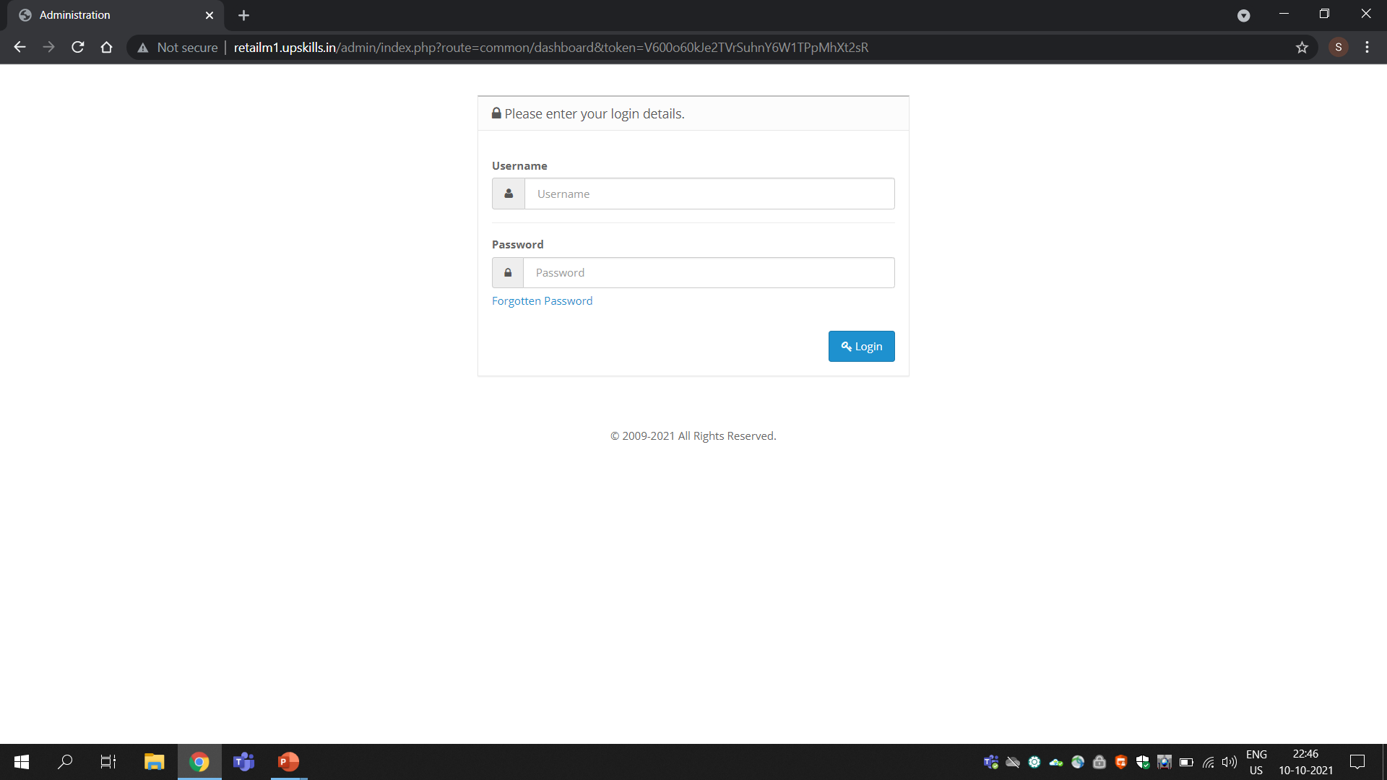
Login Page Admin
Here we can see the interface for admin login page
Admin needs to enter username and password to login in
Here admin can change the password too.

Slide 17
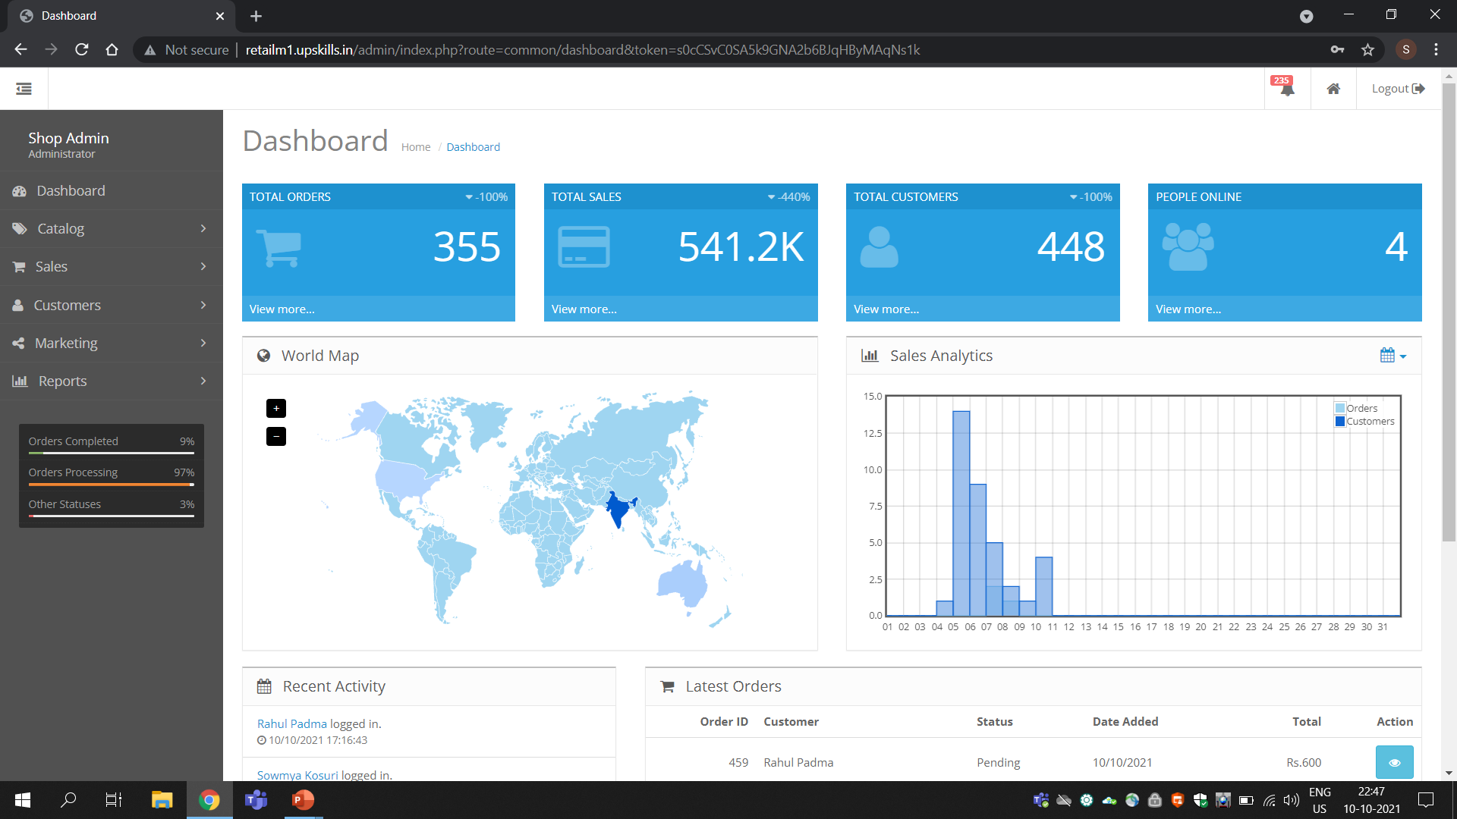
Dashboard
Here in dashboard admin can find everything
Like total orders, sales customers etc…
It is handy instead of going into every section

Slide 18
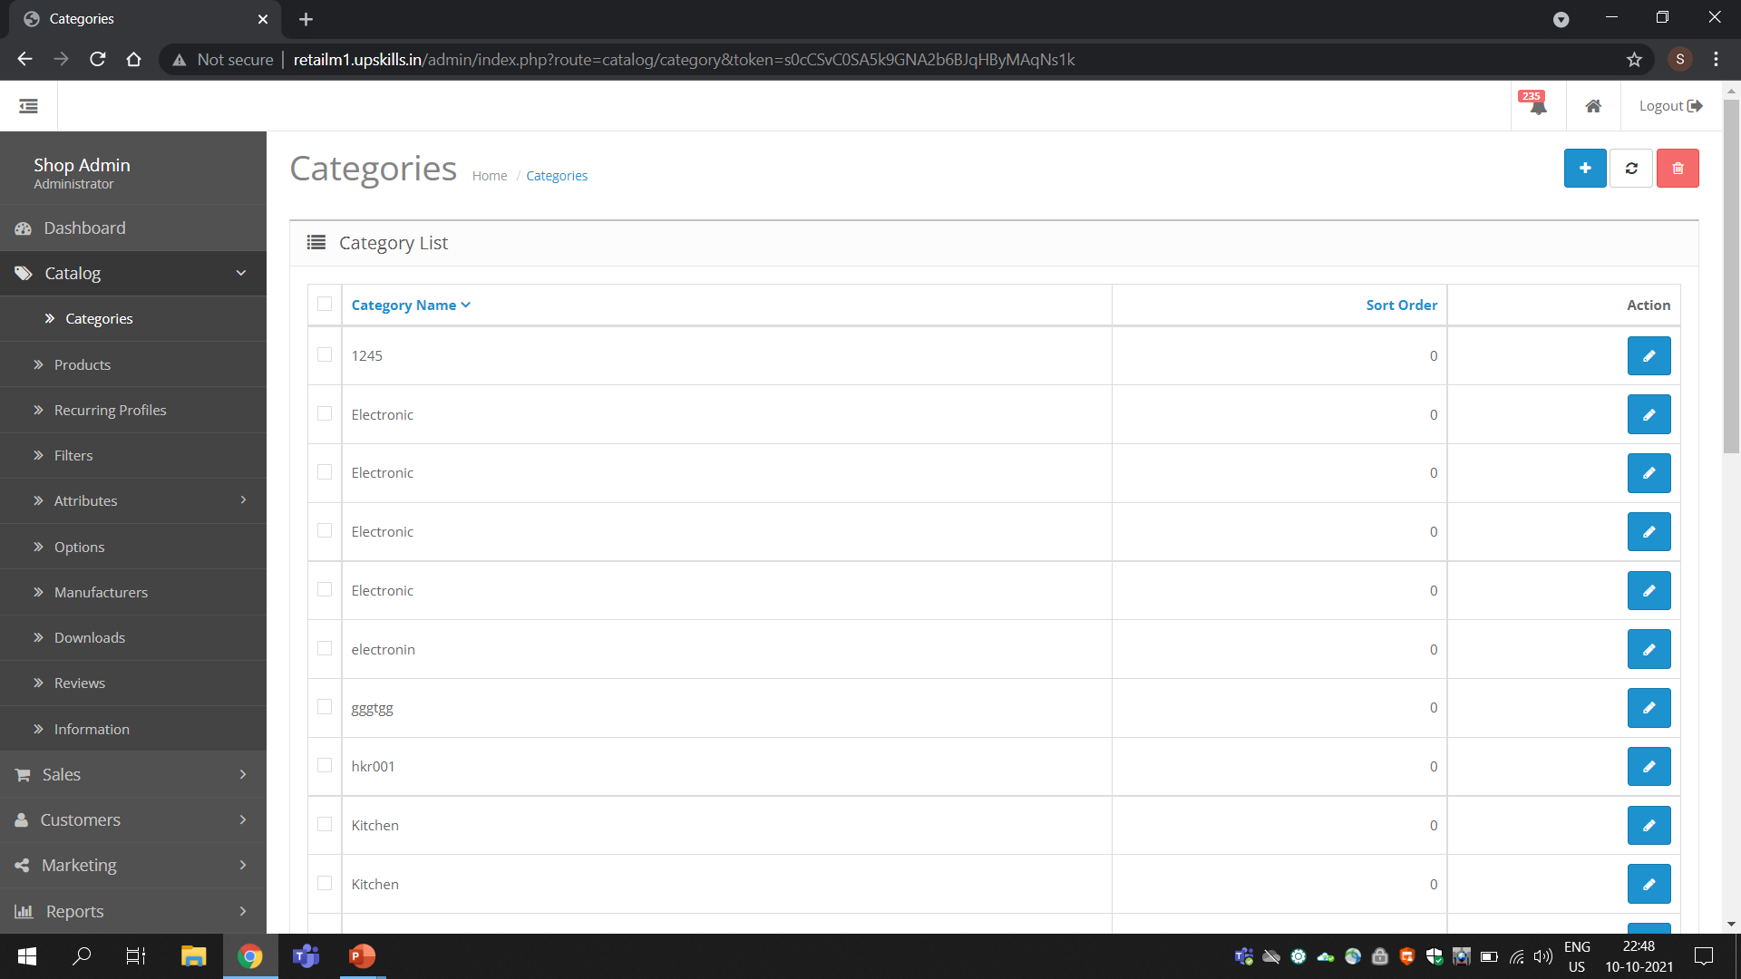
Catalog
There are 10 categories under catalog alone
In catalog we’ll mainly focus on how to add
Categories, products, recuring profiles, filters, attributes
Options, Manufacturers, Downloads, Reviews and Information

Slide 19
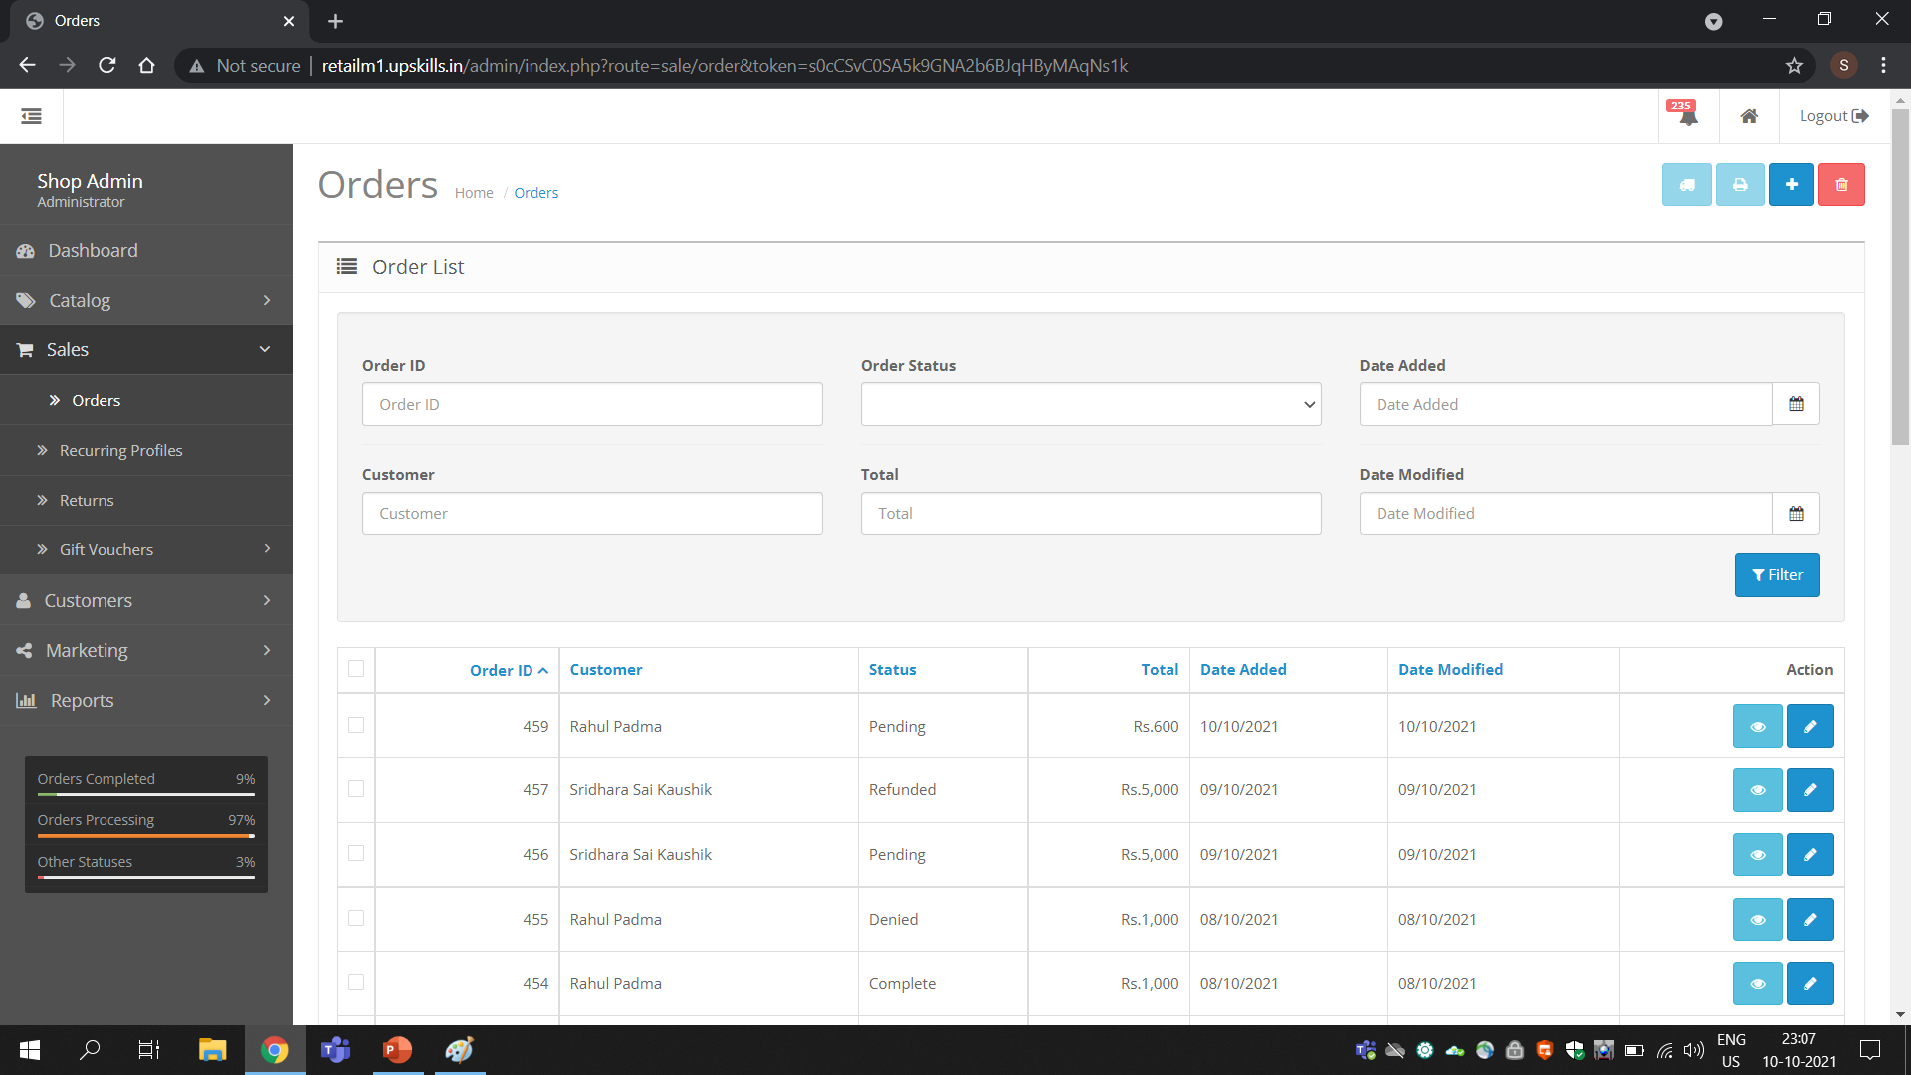
Sales
Sales, since our website is an e-commerce, so sales plays a crucial role
So here in sales we mainly focus here on
Orders
Recuring Profiles
Returns
Gift Profiles

Slide 20
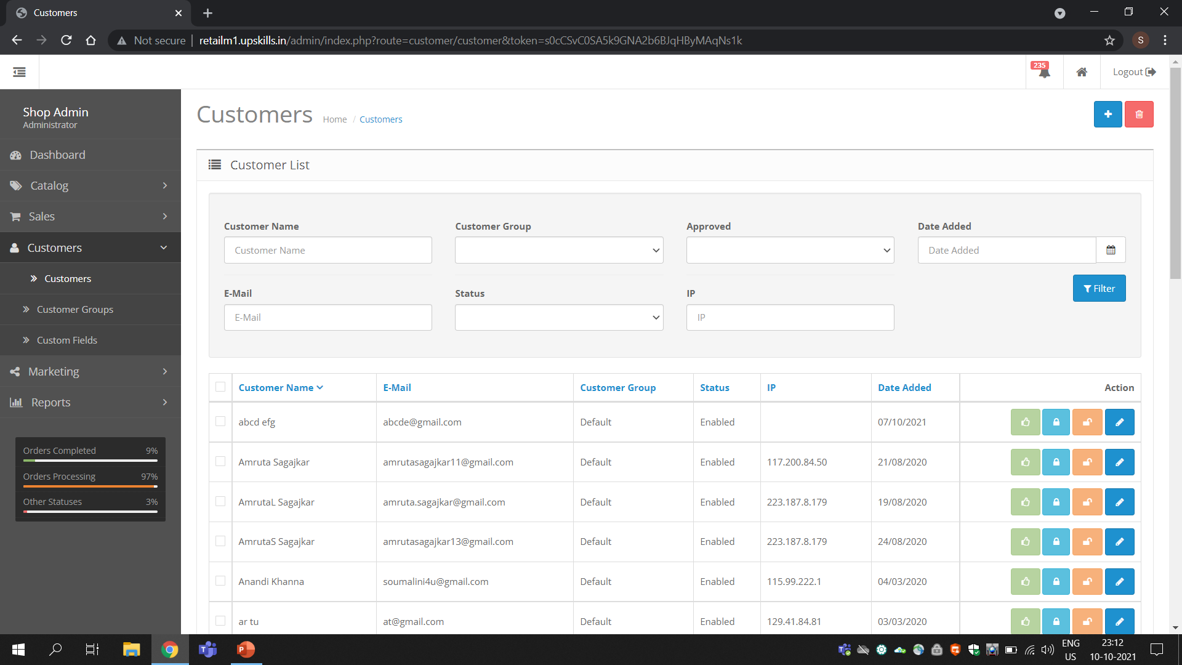
Customers
In Customers Admin is able to access the Customer profile
Even personal information is can be accessed by the admin
Admin here can manage customers, customer groups and also customer fields

Slide 21
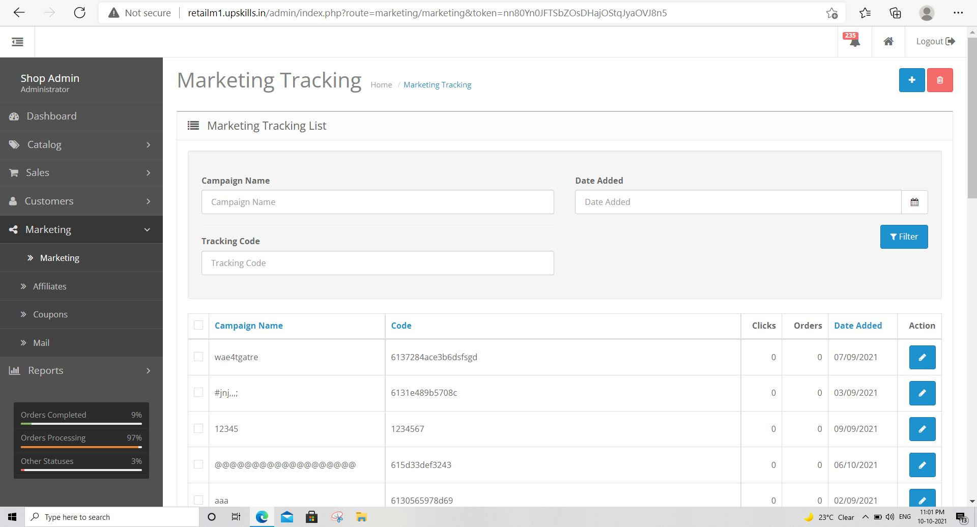
Check the response of Marketing:-
Verify the marketing functionalities for marketing.
Check the response of marketing
When we click on marketing, the marketing tracking list is opened.
Check the response of add new button

Slide 22
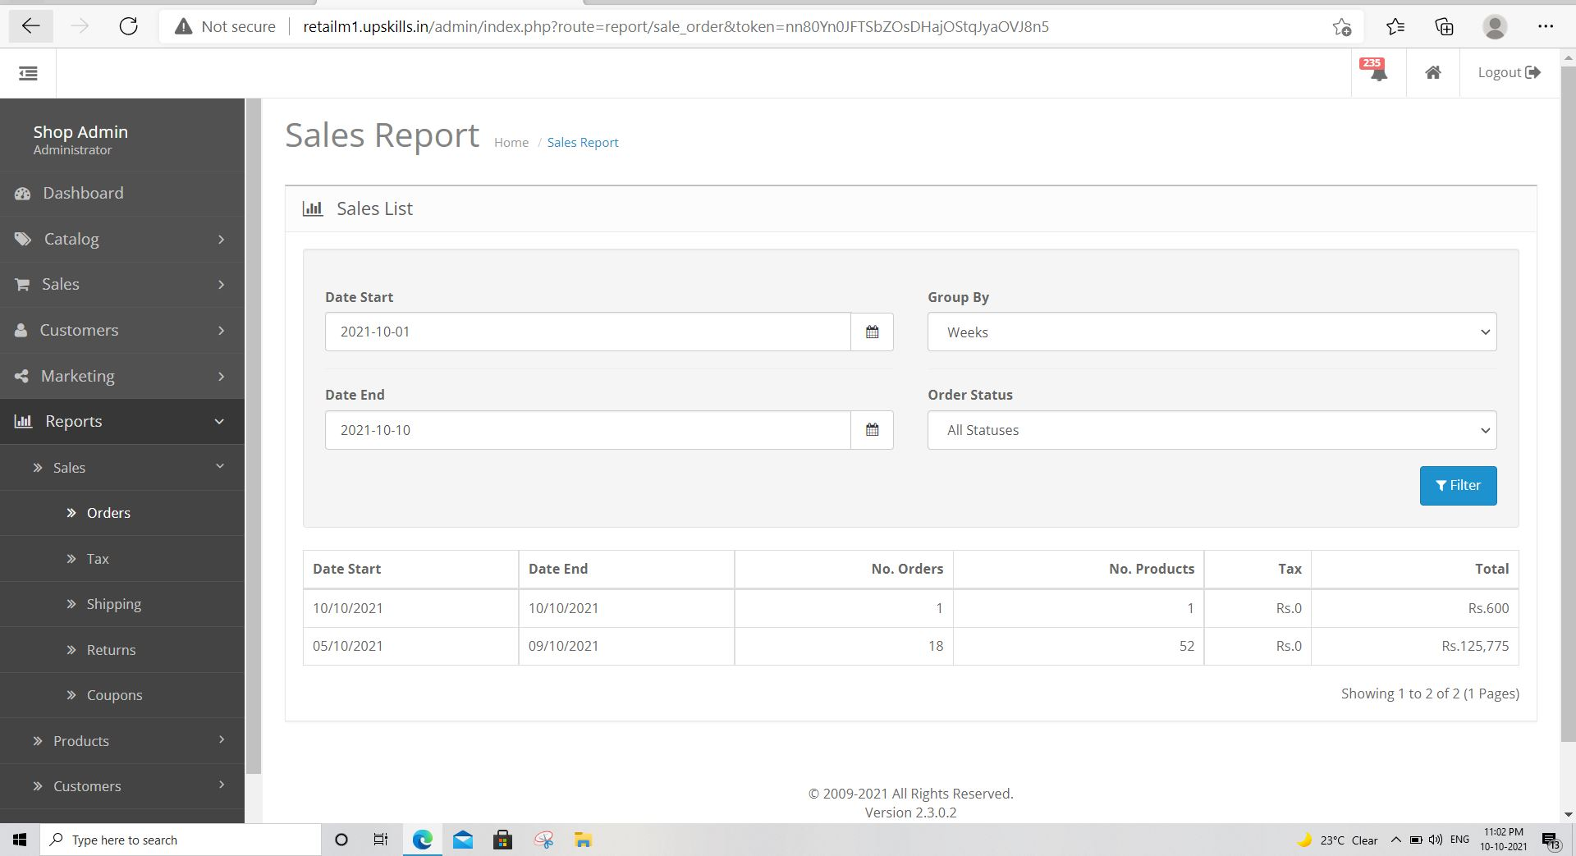
Check the response of reports:-
Verify the reporting functionalities for sales
Check the response of sales
Check the response of orders
Sales list is opened
Admin need to fill the details and click on filter

Slide 23

THANK YOU

